Slide 1

Session 1
T Level Year 2

Slide 2
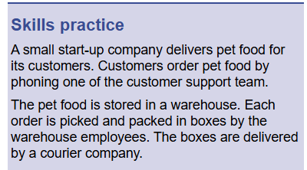
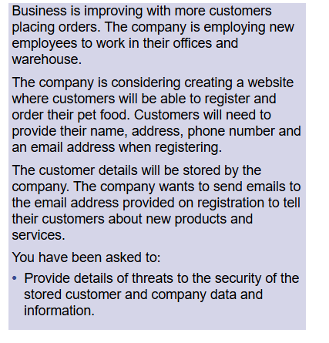
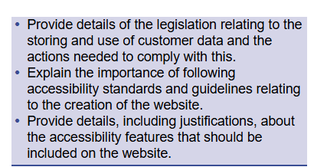
Refresh Activity 1 from last year
Activity Groups of 3
Read the following case study and answer the following points. You will deliver your findings to the group.

Slide 3

Refresh Activity 2
Please research an emerging technology and stipulate how this could help industry or society.

